Slide 1
Topten: Click your way to energy savings
Find the most energy efficient
products in Europe with
a simple click
on Topten websites
Nicolas Dyèvre on behalf of Therese Kreitz, ADEME
February 2019

Slide 2
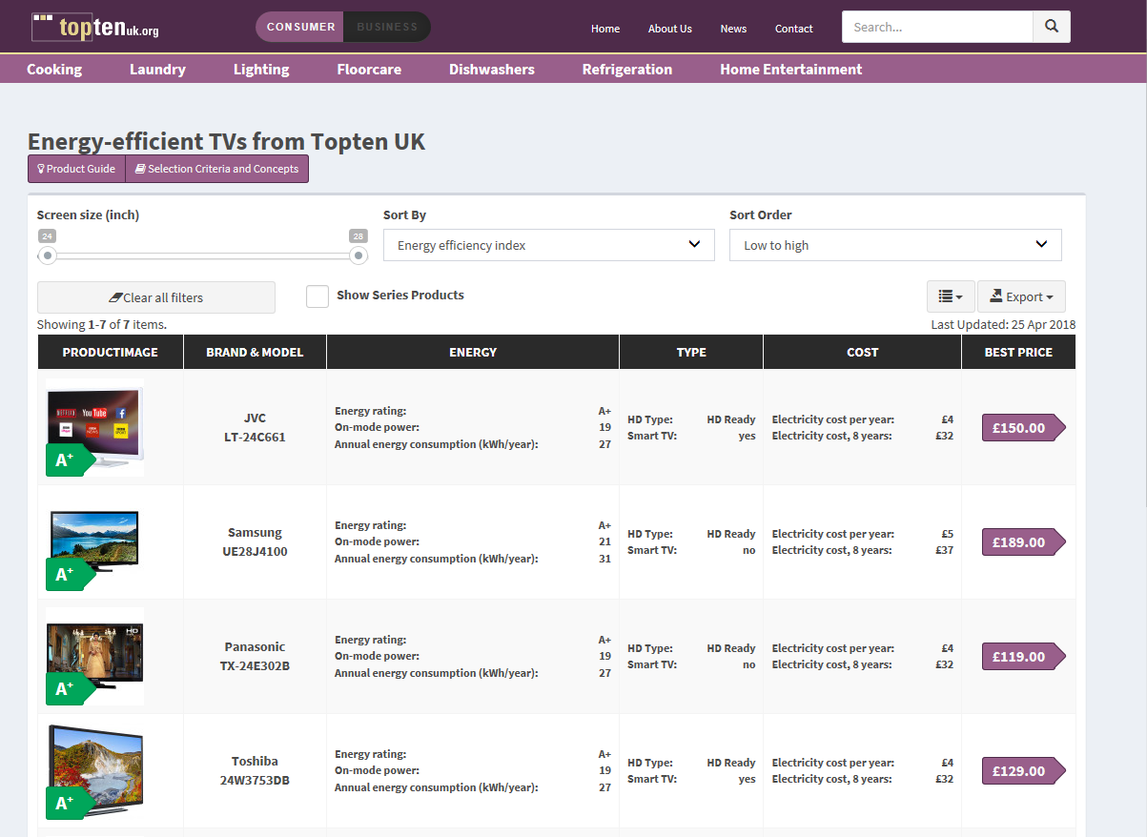
Market transparency: Topten identifies and shows best products online - Example UK

Slide 3
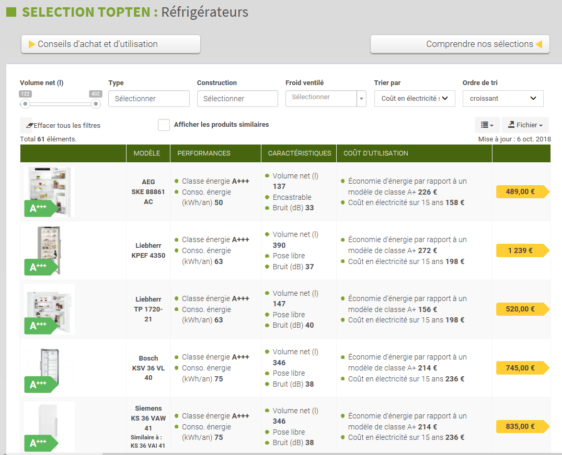
Market transparency: Topten identifies and shows best products online Example FR

Slide 4
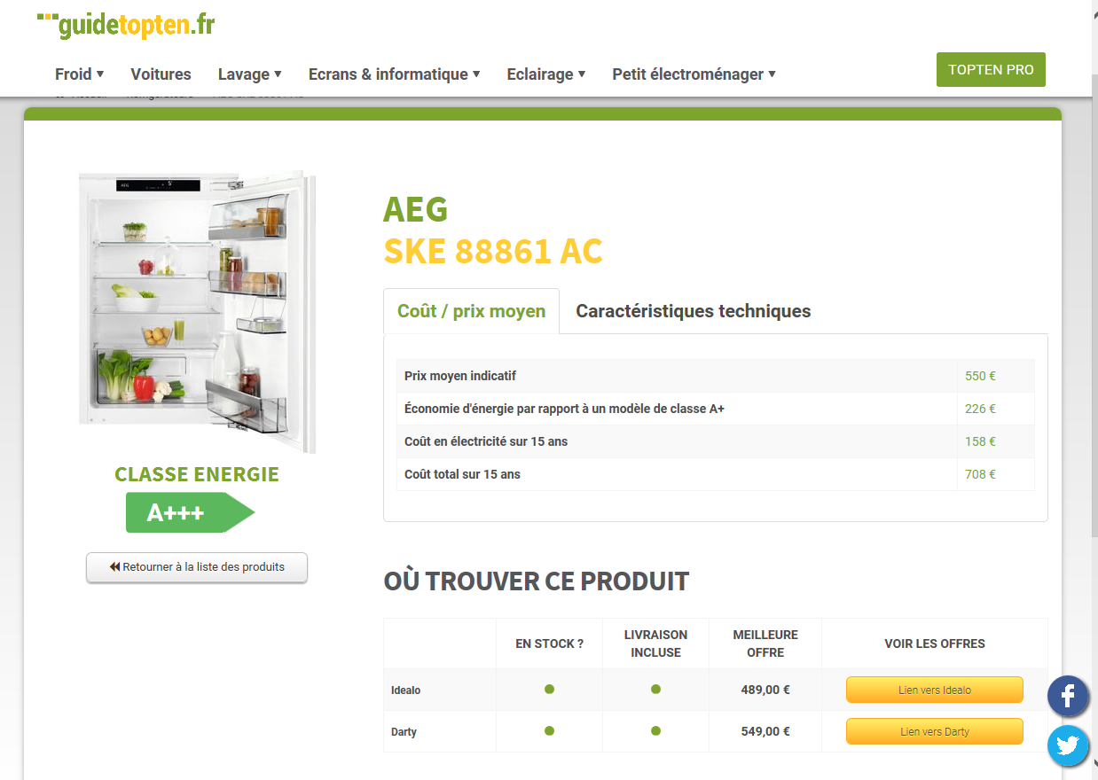
New software - Link to the Point of Sale

Slide 5
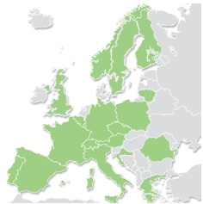
Euro-Topten: a long story, a strong recognition
Under the coordination of ADEME:
2006 – 2008: IEE Euro-Topten 12 partners – white goods
2009 – 2011: IEE Euro-Topten Plus 20 partners – office equipment
2012 – 2014: IEE Euro-Topten Max 21 partners, 19 websites –
professional buyers
2015 – 2018: H2020 ProCold 8 partners, 7 websites –
professional cold appliances
    2015 – 2018: H2020 Topten ACT 16 partners, 17 websites - collaboration with retailers
    2019 – 2021: HACKS (Heating And Cooling Knowhow and Solutions ) – 17 partners, 16 websites -cooling and
    heating appliances
The HACKS project have received funding from the European Union’s Horizon 2020 research and innovation programme under grant agreement No 649647 and No 649293 respectively.
The sole responsibility for the content of these projects lies with the authors. It does not necessarily reflect the opinion of the European Union. Neither the EASME nor the European Commission and the project partners are responsible for any use that may be made of the information contained therein.

Slide 6
HACKS- Heating And Cooling Knowhow and Solutions
Best products in your country
    Horizon 2020 grant, 2019 - 2021
    A global budget of 2 159 088 Euros
    17 national Topten teams in 15 countries
    Showing the best products on national markets
    Special focus: market transformation for heating and cooling (HAC) appliances:
      Motivating consumers to replace old and inefficient equipment with new energy efficient equipment;
      Encourage solutions that consume less fuel, lower energy bills and improve users’ comfort and health.
    In the EU, almost half of all buildings have individual boilers installed before 1992, with efficiency of 60% or less

Slide 7
Partners
1 AGENCE DE L'ENVIRONNEMENT ET DE LA MAITRISE DE L'ENERGIE France
2 OSTERREICHISCHE ENERGIEAGENTUR AUSTRIAN ENERGY AGENCY Austria
3 GoodPlanet Belgium Belgium
4 BUSH ENERGIE GMBH Switzerland
5 SEVEN, THE ENERGY EFFICIENCY CENTER Z.U. Czech Republic
6 CO2ONLINE GENUETZIGE BERATUNGSGESELLSCHAFT MBH Germany
7 FUNDACION ECOLOGIA Y DESARROLLO Spain
8 GUIDE TOPTEN SARL France
9 SOCIETA COOPERATIVA SOCIALE ELIANTE ONLUS Italy
10 POLITECNICO DI MILANO Italy
11 LIETUVOS NACIONALINE VARTOTOJU FEDERACIJA ASOCIACIJA Lithuania
12 OEKOZENTER PAFENDALL ASBL Luxembourg
13 NORGES NATURVERNFORBUND Norway
14 FUNDACJA NA RZECZ EFEKTYWNEGO WYKORZYSTANIA ENERGII Poland
15 Quercus - Associação nacional de Conservação da natureza Portugal
16 SVENSKA NATURSKYDDSFORENINGEN I Sweden
17 THE ENERGY SAVING TRUST LIMITED United Kingdom

Slide 8
Methodology
HACKS will engage consumers by assisting them during the purchasing process of new HAC equipment.
The online platforms will provide tools to receive customized information, interactive comment functions, product information, and direct links to the suppliers of the product.
The online platforms will also provide guidance on how to improve consumers' situation while avoiding the purchase of unnecessary equipment as well as how to use and maintain devices.
HACKS will work with all relevant stakeholders (“the multipliers”) that participate in the decision-making process of consumers by setting up strategic partnerships to promote and facilitate the purchase of energy efficient installed appliances.
HACKS will place a strong emphasis on installers, retailers and consumer organisations because of their proximity to the consumers and capacity to involve and bring guidance on energy efficient equipment directly to them.

Slide 9
HACKS: Fast selection, best choice
Purpose: convince manufacturers through multinational pressure that a demand exists for efficient products and support market transformation towards more sustainable products.
TOPTEN websites identify and display selection of best products available in 15 countries. A common portal www.topten.eu gives access to each of the 15 websites which are tailored to national consumers and markets.
Market stimulation: Promotion of energy efficient equipment through stakeholder engagement all along the supply chain.
Dissemination activities: websites, media coverage, press releases, newsletters, social networks.

Slide 10
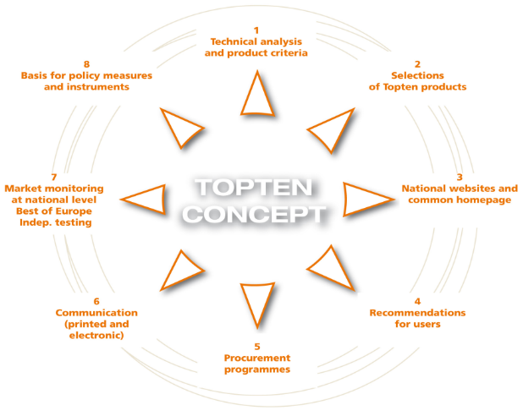
Topten Concept

Slide 11
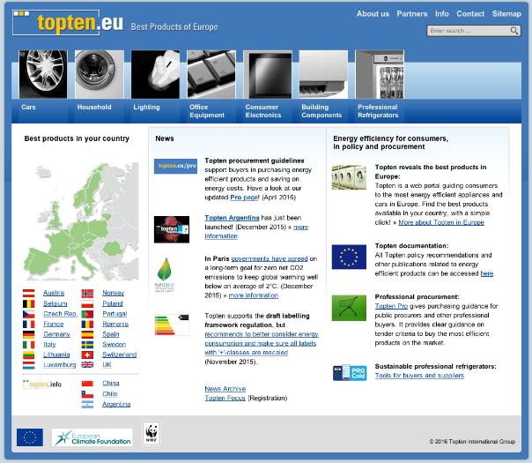
Topten Act: access from www.topten.eu

Slide 12
Topten.eu – Best products of Europe
Lists of most efficient products of Europe (27 categories)
Regular updates of product lists and selection criteria
Evidence on Best Available Technology (BAT)
    Based on up-to-date BAT and selection criteria:
Policy Recommendations for effective MEPS and labels
‘Topten Focus’ on key topics: mailings to 400 stakeholders from policy and research (registration form on topten.eu)
Advice to product policy stakeholders
➔ exchange with Energy Agencies are very welcome!
Notes:
25 product categories: Household appliances, office equipment, TVs, building components, lighting, professional refrigeration, cars

Slide 13
Circular Economy:
Same approach needed as for energy efficiency
Labels and MEPS
Requirements for declarations
Market analysis and benchmarking
Standards and measurement methods

Slide 14
Questions
If you simply want to know more about
Please contact :
Therese Kreitz Therese.kreitz@ademe.fr
Sophie Attali sattali@sowatt.net

