Slide 1
Buildings Working Group
Activity Report
M67 meeting
25th September 2020
Rui Fragoso, ADENE

Slide 2
BWG recent activities
Horizon 2020 calls – 2 proposals with EnR members
ACT2SHARE - energy poverty ACTions TO Social, HeAlth and Economic Recovery
SEJ - Supporting Energy Justice
Preparation of meeting with EU Commission on the Renovation Wave
Support to the meeting between EnR and EC

Slide 3
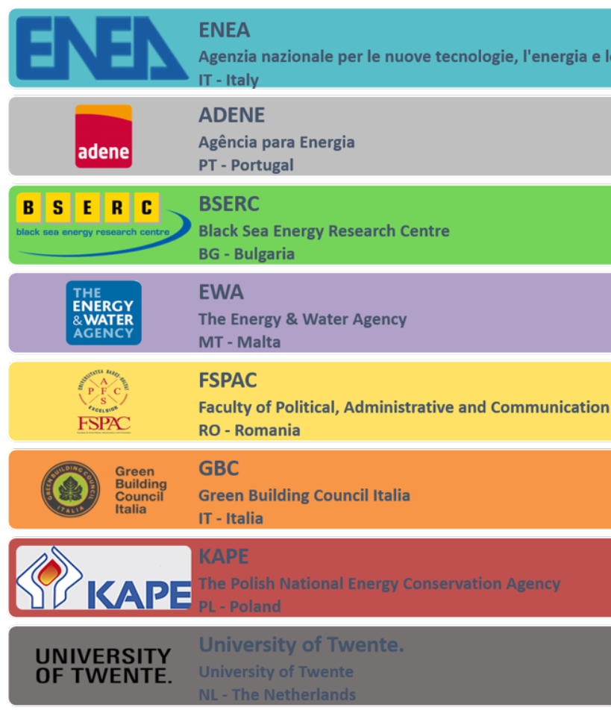
ACT2SHARE - energy poverty ACTions TO Social,
HeAlth and Economic Recovery
Call ID: Mitigating household energy poverty
Submission: 10th September
Coordination: ENEA (Italy)
Objective:
To support the design and the replication of innovative measures aiming to enhance the living conditions and indoor comfort of energy poor households, by exploiting also the potential role and impact of women in pursuing the social urgent scope of mitigating energy poverty. Energy efficiency measures can highly contribute to the economic recovery post Pandemic and to a faster rate of green renovation.
EnR member

Slide 4
SEJ - Supporting Energy Justice
Call ID: Mitigating household energy poverty
Submission: 10th September
Coordination: EST (UK)
EST – Coordinator | UK
ENEA | IT
CRES | GR
IDAE | ES
KAPE | PL
EIHP | HR
ADENE | PT
RAP | BL
IETcc-CSIC | ES
Moita Municipality | PT
Objective:
The aim of the project is to alleviate energy poverty and promote a fair transition to a low carbon society by enabling energy poor households to access and maximise the benefits from energy efficiency and renewable energy support schemes, both by directly assisting households in seven countries, and by demonstrating a set of principles and practices that can be applied in energy efficiency, RES and other energy poverty support schemes and policies across Europe
EnR member

